Slide 1

8) Discriminant Analysis (cont.), and Logistic Regression

Slide 2
Recall the last set of slides presented discriminant analysis where linear functions of the original variables are used to describe group differences. Objectives included determining the optimal dimensions to best illustrate group differences, and identifying the relative contribution of the original variables regarding group separation.
That analysis is attributed to a famous statistician named Ronald Fisher. In addition, we used our results to perform classification. While Fisher’s methods are standard for describing and summarizing group differences, there are other methods to perform classification that may outperform Fisher’s approach in certain applications.
This set of notes presents two other approaches to classification.

Slide 3
Example:
Recall the example from the last deck where a firm was interested in description and prediction/classification of employee job category (Sales, Brand Management, Mkt. Research) based on a test that scores individuals on the following dimensions: Managerial, Social, Quant.
Suppose that study was recently updated with a new data set with sample size 220. (file Job_Category.data_2.sav
We’ll start with just the Sales and Mkt. Research groups (2 group discriminant analysis)

Slide 4
Basic descriptives appear below
Note that unlike the previous data set, here the group sizes are unequal.
Our previous classification procedure (Fisher’s) does not incorporate this type of information.

Slide 5
For classification, Fisher’s approach did not incorporate any prior information about the likelihood of belonging to any particular group.
The group size prior information can be used in addition to the previous discriminant analysis as weights which can improve the chance of making correct classification predictions.
The group size proportions are prior information since it is known prior to the analysis.

Slide 6
In SPSS to incorporate group size information in classification, click Compute from group sizes in the Classification option under Prior Probabilities
To save the posterior probs., click Probabilities of group membership under the Save option

Slide 7
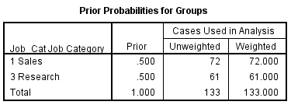
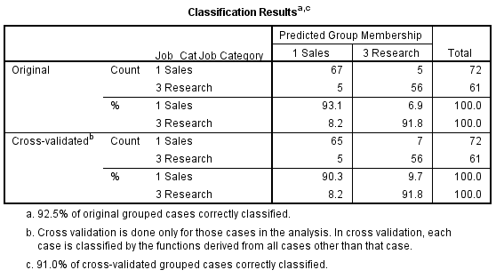
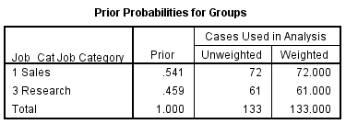

Returning to our example, classifications were run with and without equal priors:

Slide 8
Benchmark Measure of Predictive Accuracy
Maximum chance criterion: Based on the sample size of the largest group
72/133 = .5414
Proportional chance criterion: if a= proportion of cases in group 1, b= prop. of cases in group 2,
the proportional chance criterion = a² + b² =
(72/133)² + (61/133) ² =
(.5414)² + (.4586) ² =
.2931 + .2104 = .5035

Slide 9
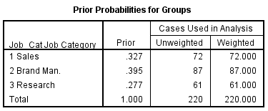
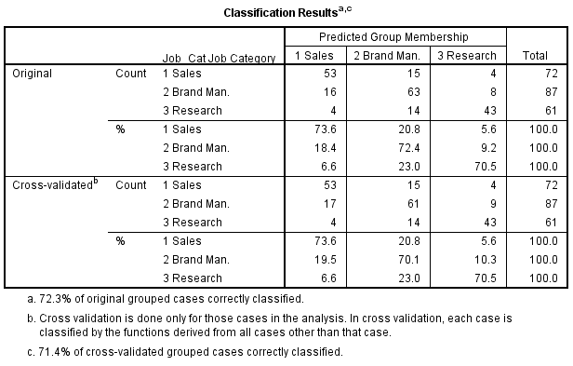
Performing classification for all 3 groups produces the following.

Slide 10
Logit Models
Binary Logit
Overview
Consider the following scenarios:
An auditor is interested in determining the probability that a certain type of firm will fail based on certain characteristics of the firm such as financial ratios.
A marketer is interested in determining the probability that a household would subscribe to a particular package of premium channels given household characteristics such as income, occupation, number of children, etc.
While regression models are used to address similar type problems, a characteristic of the above scenarios is that the dependent variable is binary (a particular firm has either failed or hasn’t failed, a household either subscribes to the package of premium channels or doesn’t subscribe).
Logit models are well suited to address problems of this type (binary dependent variable, interested in predicting a certain probability).

Slide 11
For classification applications, recall Fisher’s approach and also the classification approach using prior probabilities.
In general, logit has advantages over those procedures for certain applications. If the assumptions of those procedures are not met, logit may be a viable alternative.
Logit does not require any normality assumption regarding the explanatory variables. Therefore, it is a natural choice when that assumption is not met (e.g., if at least some explanatory variables are categorical such as marital status, gender, etc.)

Slide 12
Logit Basics
Example
A researcher is interested in probability of bankruptcy for firms. A sample of 198 firms was obtained and a couple financial ratios recorded (see below), along with whether the firms went bankrupt after 2 years (Y=1 if solvent, 0 if bankrupt).
Ratios: X1 = Retained earnings/total assets, X2= EBIT/total assets
Estimate an appropriate model to allow for predictions.
From the logit formulation, the probability of solvent, given the explanatory variable values is:
Pr(Solvent (Y=1)| x1,x2) = EXP(β₀ + β₁ x1 + β₂ x2 )/(1 + EXP(β₀ + β₁ x1 + β₂ x2 ))
We want to estimate the β^{s} to develop an operational model that can be used for description and prediction.

Slide 13
Interpretation of binary logit estimation and testing results
P-values for overall and individual coefficient tests can be interpreted in the usual fashion.
Suppose a firm has the following information for the explanatory variables:
Retained earnings/total assets(x1)= 9.0, EBIT/total assets(x2)=2.0 What is the predicted chance of bankruptcy?

Slide 14
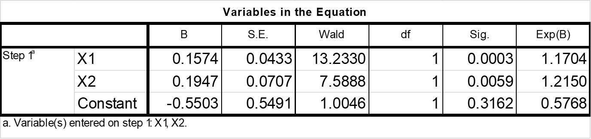
Solvent probability
P(Y=1) = EXP (-.5503 + .1574 X1 + .1947 X2) _
EXP (-.5503 + .1574 X1 + .1947 X2) + 1
P(Y=1) = EXP (-.5503 + .1574 (9) + .1947 (2)) _
EXP (-.5503 + .1574 (9) + .1947 (2)) + 1
= .7783
Probability of Bankruptcy = 1 - .7783 = .2217
Solvency Odds = .7783/.2217 = 3.5103

Slide 15
Odds Interpretation of the coefficients
To interpret a particular coefficient, let Pr(Solvent (Y=1)| x1,x2) = ∏
Then the ratio ∏/(1-∏) = probability that the firm is solvent after 2 years over the probability of bankruptcy (the odds).
The term EXP(β_{j}) communicates the change in the odds for a unit change in the corresponding variable Xj (holding all other variables constant).
Using our estimate for β₂ we have EXP(.1947) = 1.215.
So, for a unit increase in EBIT/total assets, we expect the odds of solvency to bankruptcy to change by a factor of 1.215 (increase of 22%), holding all other variables constant.
In general, for a one unit increase in a variable Xi the odds will change by a factor of EXP(β_{i}), or by (EXP(β_{i}) - 1)*100 %, holding all other explanatory variables constant

Slide 16
Recall Solvency Odds when X1=9, X2=2
P(Y=1) = EXP (-.5503 + .1574 (9) + .1947 (2)) _ = .7783
EXP (-.5503 + .1574 (9) + .1947 (2)) + 1
Probability of Bankruptcy = 1 - .7783 = .2217
Solvency Odds = .7783/.2217 = 3.5103
Solvency Odds if Increase X2 by 1, X1=9, X2=3
P(Y=1) = EXP (-.5503 + .1574 (9) + .1947 (3)) _ = .8101
EXP (-.5503 + .1574 (9) + .1947 (3)) + 1
Probability of Bankruptcy = 1 - .8101 = ..1899
Solvency Odds = ..8101/.1899 = 4.265
Note: 3.5103*1.215 = 4.265

Slide 17
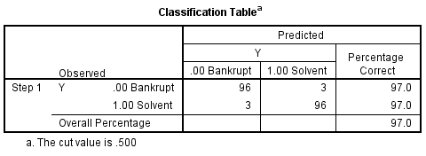
Classification using logit
Recall Fisher’s approach and also the classification approach using prior probabilities. In general, logit has advantages over those procedures for certain applications. If the assumptions of those procedures are not met, logit may be a viable alternative. Classification results using logit for our bankruptcy application are as follows:
Unfortunately, SPSS does not yet have a cross-validation feature with logit.

Slide 18
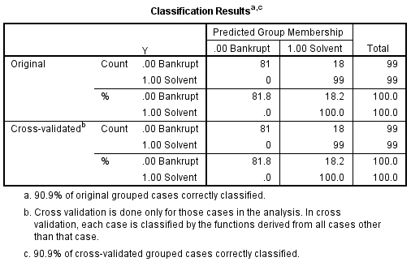
Classification results using Fisher’s approach

Slide 19
To run logistic regression in SPSS, click Analyze, Regression, Binary Logistic.
Specify the associated dependent and explanatory (covariate) variables.
For predicted probabilities, click Save, Probabilities, Continue, Ok.

Slide 20
More than 2 groups
Extending the logit model to more than two groups (multinomial logit) is straight forward. The model is extended by including the appropriate exponentiated terms.
Added Application 3)
For the Bankruptcy data set (SPSS file Audit.data.sav)
Obtain the probability of solvency for a firm with
X1 = Retained earnings/total assets=5, X2= EBIT/total assets =2
(be able to perform this in Excel)

Slide 21
SAS Code for Discrim Using Group Size Priors
proc import datafile="C:\Job_CategoryData_2.sav" DBMS=SAV OUT=jc2d;
run;
proc discrim data=jc2d can crossvalidate out=outcan;
class Job_Cat;
var Manag Social Quant;
priors proportional;
run;
/* The can option specifies Fisher's (canonical) functions */
/* priors proportional specifies using the group sizes as priors */
/* The outcan dataset contains the discrim scores on the discrim
Functions (Can1 and Can2), posterior membership probs, and predicted groups*/

